Slide 1

DIGITAL FORENSICS
DR. NILAKSHI JAIN
Email ID: nilakshijain1986@gmail.com

Slide 2
4.1 Introduction
4.2 Facts in Criminal Case
4.3 People Involved in Data Collection Techniques
4.4 Live Data Collection
4.5 Live Data collection from UniX system
CHAPTER FOUR
Live Data Collection

Slide 3
Introduction
4.1 Introduction
4.2 Facts in Criminal Case
4.3 People Involved in Data Collection Techniques
4.4 Live Data Collection
4.5 Live Data collection from UniX system
The term “computer forensic” involves identification, sunder out, preparation of documents, and storing information that is kept or sent over in electronic or magnetic form basically considered as digital evidence
Different standards have been created which are used to find out and preserve digital evidences There are a number of the procedures accepted by law. Those are:
If evidence is not collected and handled according to the proper standards, the judge may deem the evidence inadmissible when it is presented and the jury members will never get a chance to evaluate it or consider it in making their decision.
If the proof is admitted, the opposing lawyer can attack its quality by questioning the witnesses.

Slide 4
4.1 Introduction
4.2 Facts in Criminal Case
4.3 People Involved in Data Collection Techniques
4.4 Live Data Collection
4.5 Live Data collection from UniX system
The Facts in a Criminal Case
Legal process of searching, examining, preserving, and exhibiting facts or evidence is generally governed by the law of authority of the court. This process will introduce an evidence
1.Definition of Evidence:
Evidence can generally be defined as the means by which an alleged fact, the truth of which is subjected to scrutiny, is established or disproved. The legal significance of any given piece of evidence lies in its influence on the judge or jury at trial. —Debra Little John Shinder

Slide 5
The Facts in a Criminal Case
4.1 Introduction
4.2 Facts in Criminal Case
4.3 People Involved in Data Collection Techniques
4.4 Live Data Collection
4.5 Live Data collection from UniX system
2.Evidence Admissibility
There are certain requirements for evidence to be admissible or acceptable by court:
1. Evidence should be competent.
2. Evidence should be relevant.
3. Evidence should be material.
4. Evidence should be obtained legally.
Standards of Forensic Examination
Standards regarding some digital evidence handling are:
1. The originality of the evidence should be preserved.
2. There should be an exact copy of the original, if possible, in order to maintain integrity of the evidence.
3. The copies should be preserved on a disk with no other documents available on the disk. That is, disk should be cleaned before placing copies in it.
3.Collection of Digital Evidences
The first person to become aware of a cybercrime is always a network administrator. Integrity in investigation team members is also an essential part in order to collect evidences successfully.

Slide 6
People Involved in Data Collection Techniques
4.1 Introduction
4.2 Facts in Criminal Case
4.3 People Involved in Data Collection Techniques
4.4 Live Data Collection
4.5 Live Data collection from UniX system
There are several people involved in evidence collection techniques—first respondent (usually an officer or a security person), investigators (usually a senior investigator), and the crime scene technicians (usually a person who is an expert in computer forensic). These people have been assigned with specific roles.
Role of First Respondent
The first respondent is the one who appears in crime locations, usually an officer or a security person.
He/she should follow the following process:
Identifying the crime location
Protecting the crime scene
Preserving temporary and tampered evidences

Slide 7
4.1 Introduction
4.2 Facts in Criminal Case
4.3 People Involved in Data Collection Techniques
4.4 Live Data Collection
4.5 Live Data collection from UniX system
People Involved in Data Collection Techniques
Role of Investigators
IT incident response team has authority of collecting evidences before any law enforcement team arrives.
He/she will be responsible for:
A Chain of order:
An investigator should make sure that everyone at the crime scene is aware of the chain of order. Chain of order refers to the flow investigation process.
2. Conducting the crime scene search:
Officers should seek all the systems, written documents and notes, manuals, and log files related to the crime.
3. Preserving integrity of the facts or evidences:
Criminals always remove all the evidences. This is the reason to preserve all the evidences in order to take actions against the offender. Investigation should make exact copy of all the evidences, if possible and should be able to analyze the footprints of attacker/criminal.

Slide 8
4.1 Introduction
4.2 Facts in Criminal Case
4.3 People Involved in Data Collection Techniques
4.4 Live Data Collection
4.5 Live Data collection from UniX system
People Involved in Data Collection Techniques
Role of Crime Scene Technicians:
Preserving temporal evidences to replicating disks
Shutting down the computer system for transport
Marking and recording the evidence
Packaging of the evidence
Transporting evidence
Processing the evidence

Slide 9
Live Data Collection
4.1 Introduction
4.2 Facts in Criminal Case
4.3 People Involved in Data Collection Techniques
4.4 Live Data Collection
4.5 Live Data collection from UniX system
Live Data Collection from Windows System
The first step is to determine whether the system was used by the victim or the attacker.
Creating a Response Toolkit
Collecting the tools
There are two types of applications available in windows:
1. Based on GUI (Graphical User Interface)
2. Based on CUI (Control User Interface)
2. Preparing the response toolkit:
There are several stages to prepare toolkit for initial response:
1. Tag a response toolkit media
2. Check the dependencies
3. Creating checksum for the response toolkit

Slide 10
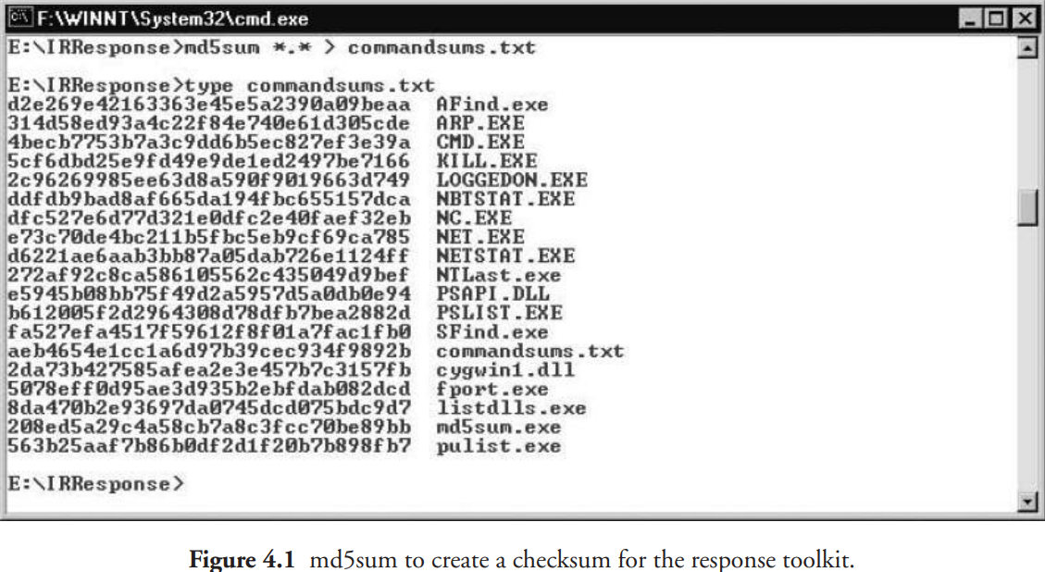
Live Data Collection
4.1 Introduction
4.2 Facts in Criminal Case
4.3 People Involved in Data Collection Techniques
4.4 Live Data Collection
4.5 Live Data collection from UniX system
3. Preparing the response toolkit
There are several stages to prepare toolkit for initial response:
Tag a response toolkit media
Check the dependencies
Creating checksum for the response toolkit

Slide 11
4.1 Introduction
4.2 Facts in Criminal Case
4.3 People Involved in Data Collection Techniques
4.4 Live Data Collection
4.5 Live Data collection from UniX system
Live Data Collection
Saving Information Collected During Initial Response
There are four options available when the information has been retrieved from the live system:
. The information obtained from the hard drive of the target system should be saved.
The obtained data should be noted by hand.
The data obtained from the floppy disks or other external devices should be saved.
The obtained data should be stored from forensic system by using cryptcat or netcat.
Netcat is a widely used tool to transfer the data from target system to remote forensic workstations.

Slide 12
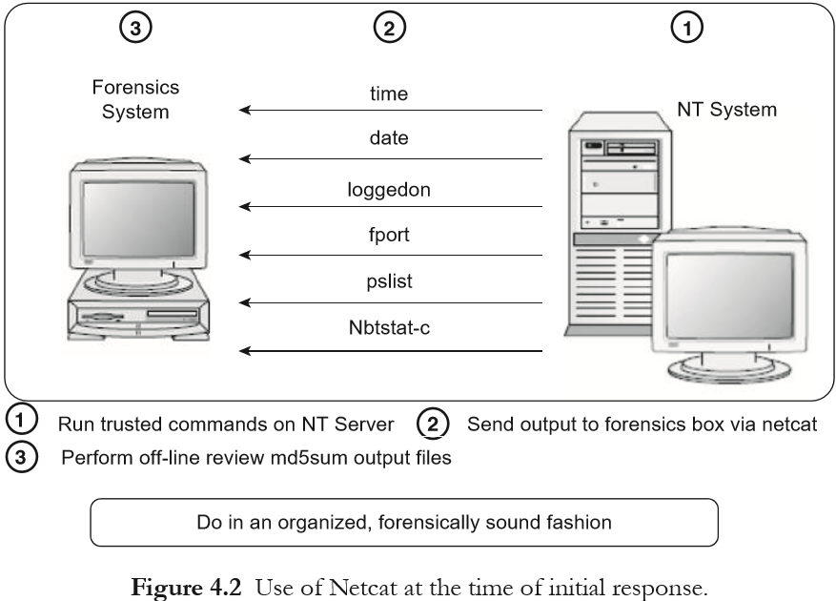
Live Data Collection
4.1 Introduction
4.2 Facts in Criminal Case
4.3 People Involved in Data Collection Techniques
4.4 Live Data Collection
4.5 Live Data collection from UniX system
Moving of Data Using Netcat
Netcat is a freely available tool that can be used to establish a communication channel between hosts.
There are two practices promoted by this technique:
It helps to quickly get on and off the target system.
It also provides offline feature of reviewing the information which was previously attained.
We need to initialize a Netcat listener on the forensic work station. We also need to redirect all the incoming data. Figure 4.2 shows the incoming connection on port 2222. The file called pslist will contain all the information received on the port 2222. The output to the response command is provided to the forensic workstations by using Netcat on the target system. Figure 4.3 runs the command for pslist, by sending the output to the forensic workstation with the IP address 192.168.0.20.

Slide 13
4.1 Introduction
4.2 Facts in Criminal Case
4.3 People Involved in Data Collection Techniques
4.4 Live Data Collection
4.5 Live Data collection from UniX system
Live Data Collection
Obtaining Volatile Data
We collect the following temporal/volatile data before forensic duplication:
The date and the time of the system.
List of users that are currently logged on.
Entire file system’s time and date stamp.
List of processes that are currently running.
List of sockets that are open currently.
Applications that are listening on the open sockets.
List of systems that have current or had recent connections to the system.

Slide 14
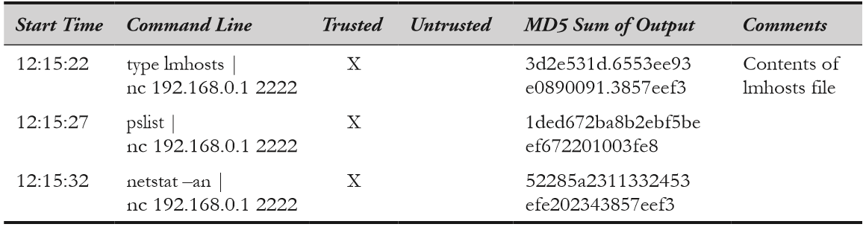
4.1 Introduction
4.2 Facts in Criminal Case
4.3 People Involved in Data Collection Techniques
4.4 Live Data Collection
4.5 Live Data collection from UniX system
Live Data Collection
Documenting and Managing the Investigation
For accurate incident response, it is necessary to have technical skills. Practices that are documented and organized are important.
There are two main reasons for documenting the actions while responding to the victim system:
To protect an organization to which you belong.
. To collect the data that may become evidence against the offender or criminal.
An example of this form is illustrated in the following table:

Slide 15
Live Data Collection
4.1 Introduction
4.2 Facts in Criminal Case
4.3 People Involved in Data Collection Techniques
4.4 Live Data Collection
4.5 Live Data collection from UniX system
Collecting Temporal Data
Following are the steps used for collecting the data:
Run a Trusted cmd.exe
Recording the system time and date
Identify who has logged on to the system and who are the remote access users.
Record creation, access time, and all the modifications made to the files
Identifying open ports.
List of applications that are associated with those ports.
List of all running processes.
List of current and recent connections.
Record date and time of target system.
Commands accessed at the time of initial response.

Slide 16
4.1 Introduction
4.2 Facts in Criminal Case
4.3 People Involved in Data Collection Techniques
4.4 Live Data Collection
4.5 Live Data collection from UNIX system
Live Data collection from UniX system
Collecting the data
The following information should be collected:
Date and time of the system.
A list of users who are currently logged on.
Entire file system’s time and date stamps.
List of processes that are currently in running state.
List of currently open socket.
List of application that is listening to those open ports.
List of systems that have current or recent connections to the system.

Slide 17
4.1 Introduction
4.2 Facts in Criminal Case
4.3 People Involved in Data Collection Techniques
4.4 Live Data Collection
4.5 Live Data collection from UNIX system
Live Data collection from UniX system
For obtaining live data, following steps should be followed:
Run a trusted shell.
Record the time and date of the system.
Identify who is currently logged on to the system.
Record creation, alteration, and access time of each file.
Identify open ports
Enlist applications associated with open ports.
Identify the running processes
List the current and recent connections.
Record the time of the system.
Record the steps taken
Record cryptographic checksum.

Slide 18
4.1 Introduction
4.2 Facts in Criminal Case
4.3 People Involved in Data Collection Techniques
4.4 Live Data Collection
4.5 Live Data collection from UNIX system
Live Data collection from UniX system
Storing Information Obtained During Initial Response
Most of the UNIX variants place their log files in /var/adm. To know where the logs are stored, you need to be familiar with each variants of the UNIX system.
Following shows the binary log files of particular interest:
Utmp file accessed with w command.
Wtmp file accessed with last utility.
Last log file accessed with last log utility.
Process accounting logs accessed with lastcomm utility.
Some ASCII text log files are as follows:
Xferlog
Web access logs
History files

Slide 19
4.1 Introduction
4.2 Facts in Criminal Case
4.3 People Involved in Data Collection Techniques
4.4 Live Data Collection
4.5 Live Data collection from UNIX system
Live Data collection from UniX system
Obtaining Important Configuration Files
Here is the list about which file should be obtained during initial response:
To look for unauthorized user accounts: /etc/passwd.
To ensure about password authentication of every account: /etc/shadow.
To look for escalation in scope of access and privileges: /etc/groups.
To list the DNS (Domain Name System) entries: /etc/hosts.
To review trusted relationships: /etc/hosts.equiv.
To look in the start-up files: /etc/rc.
To list scheduled events: crontab files.
Dumping System RAM
There is no proper way to dump the system RAM on the UNIX system. We normally transfer /proc/kmem or /proc/kcore file from the target system. These files contain the files of system RAM in discontinuous manner. Core dump type of analysis can be done by very few people.

Slide 20
Dr. Nilakshi Jain
Thank you
Email ID : nilakshijain1986@gmail.com

